Slide 1
Mapping Options for SEND Co-production in Birmingham Tony Bovaird & Maria McCaffrey

Slide 2
Mapping of SEND Co-production in Birmingham
The first reporMapping of SEND Co-production in Birmingham has shown that there is a lot of co-production going on but it is small scale and local. It is not systemic. That needs to change. In this report we set out a range of options for future SEND co-production in Birmingham which public service organisations could quickly test and embed in their practices.
The first report of the Mapping of SEND Co-production in Birmingham showed that there is a lot of co-production going on
… based on interviews with 60+ stakeholders in the SEND system, plus groups of parents, carers & young people, it identified 48 SEND co-production initiatives
Almost all interviewees emphasised future importance of more co-production
Co-design & co-delivery more common than co-commissioning & co-assessment
However, these positive initiatives tend to be small scale, time-limited and local, e.g. around a school or a nursery or a hospital, not systemic. That needs to change.
In the second phase of the mapping exercise we have set out a range of options for future SEND co-production in Birmingham, many of which public service organisations could quickly test and embed in their practices, while others will require long-term change processes.

Slide 3
Mapping options for making SEND co-production wider, deeper and more effective
Methods of getting information
Seven focus groups on different aspects of SEND co-production
Comments and suggestions from parent/carer engagement events
Comments and suggestions from parent/carer forum and support groups and young people’s participation groups
Comments and suggestions from 1-2-1 discussions with individuals involved in the SEND system
Over 100 people involved

Slide 4
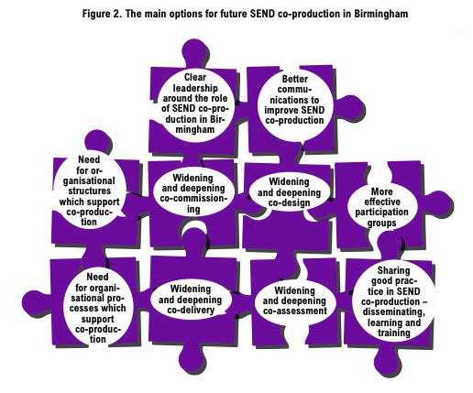
Mapping options for making SEND co-production wider, deeper and more effective:
The ‘top ten’ main options
68 OPTIONS
WITHIN THESE
HEADINGS

Slide 5
Mapping options for making SEND co-production wider, deeper and more effective
KEY POINTS EMERGING
Nearly 70 options were suggested for taking co-production further
About 35 of these have already been tried in recent years somewhere in the system
However, most sectors have very limited awareness of the full range of co-production options …
… and in every sector the experience of undertaking most co-production approaches is limited to relatively narrow, local and short term initiatives
Current approaches to taking co-production further are therefore similarly narrow and relatively uninformed
There is therefore a need to give more impetus to the embedding of co-production
Some services in the system are now taking forward some of the options outlined in this report in order to identify ‘quick wins’

Slide 6
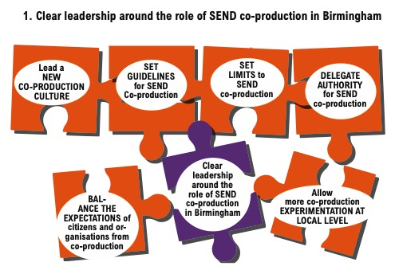
Mapping options for making SEND co-production wider, deeper and more effective:
The ‘leadership options’
SEND Advisory Teams
DEALT WITH
IN FRAMEWORK
AND CHARTER
BWCHT new
policy on
incentives

Slide 7
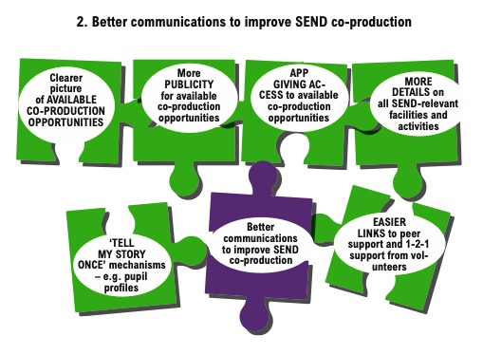
Birmingham
Health Providers
Agenda Item
BPhysioS running
Urdu sessions on
SEND system

Slide 8
SENCOs
project
PfA/Transitions
project

Slide 9
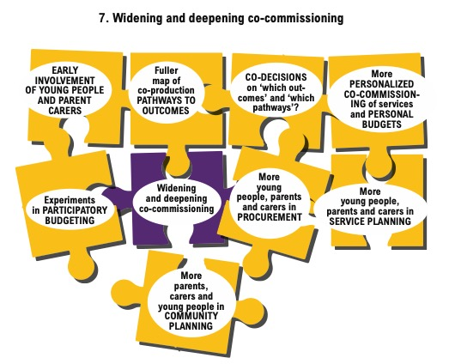
Vir
Virtual Schools
– new DPS

Slide 10
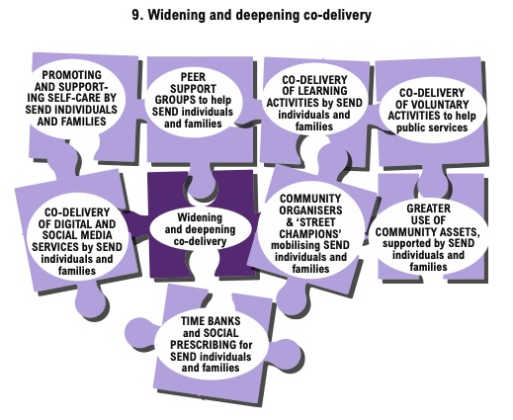
BCHC Children’s
Champions work
With CYP & PC
CIT and YES!
creating videos
for schools

Slide 11
Mapping options for making SEND co-production wider, deeper and more effective
SUMMARY AND NEXT STEPS
More experimentation is needed in each sector…
… and this experimentation generally needs to be cross-sectoral
Some ‘quick wins’ are likely to be available and will help shape the overall SEND strategy
However, relatively few of these ‘quick wins’ have yet been identified and taken forward
The SEND system is therefore not yet making the most of its own experience and expertise in co-production – there is not yet a systemic approach to co-production

Slide 12
Comments, please!
tony.bovaird@govint.org
mcp.mccaffrey@gmail.com

