Slide 1
SEND Parent Carer Survey May 2022
Headline Findings
7th June 2022

Slide 2
Parent Carer SEND Survey May 2022 – Purpose
Between May 9 and May 27, 2022, an online survey was undertaken of parent carers of children and young people accessing Special Educational Needs and Disability (SEND) services in Birmingham.
Given the need for urgent improvements to SEND services in Birmingham, we wanted parent carers with children accessing SEND services to tell us
Their views on SEND services and support and whether these are improving overall.
Their use of and perspectives on the SEND Local Offer Website (www.localofferbirmingham.co.uk).
The extent to which parent carers feel they are updated and informed, able to give feedback and influence change in SEND in Birmingham.
Provide a baseline of Key Performance Indicators (KPIs), which can be measured again through future surveys to measure progress over time.

Slide 3
Parent Carer Survey May 2022 – Approach
An online survey using Microsoft Forms – accessible on laptops and mobiles with translation and text-to-speech options. Accessibility and support was promoted but more could be done in this area next time.
Co-designed with Parent Carer Forum, NHS, Children’s Trust and Council. Over 50 people were involved.
Whole system approach across Health, Social Care and Education to try and understand the system-wide perspectives and experiences of all parent carers of children and young people with SEND (as parent carer experiences of services is a multi-agency one).
Survey was promoted via Schools Noticeboard, SENCOs and the Parent Carer Forum social media. The survey received 788 responses, significantly higher than the 378 in December 2019.

Slide 4
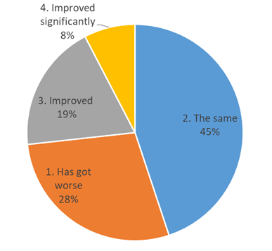
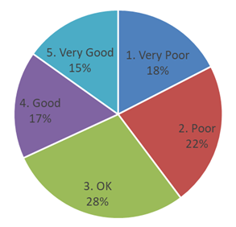
Overall satisfaction with SEND Services (all responses)
Have SEND Services improved in the last year?

Slide 5
What does good look like in the commentary (minority of comments)?
Where services are accessed and there is a positive experience with the school.
Many implied where trust had built up, where a service response is compassionate, where they feel listed to and services are ‘joined up’
Where service and response was considered high quality and timely.
Parent Carers were more likely to respond positively to School-based services and say these have improved.
Most common barriers identified
Communication, including poor listening/lack of compassion
Waiting times (especially Health) and sometimes quality of service following a wait.
Lack of face-to-face visits (especially Health)
Quality and timeliness of Assessment and Review (SENAR, Birmingham City Council)
Placement availability and transitions.
Denial of service / support (Social Care, Education and Health).
Where accessing multiple services beyond just the Educational setting / School (satisfaction and improvement scores are lower)

Slide 6
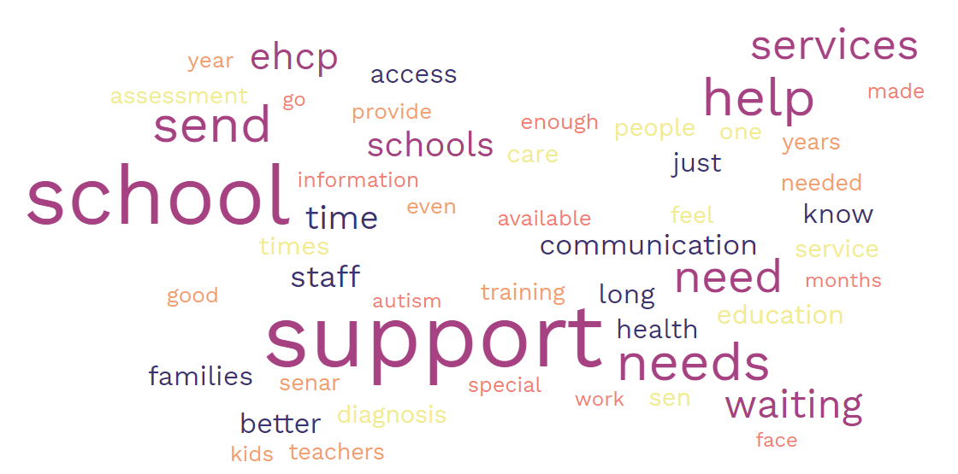

Slide 7
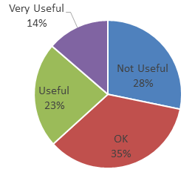
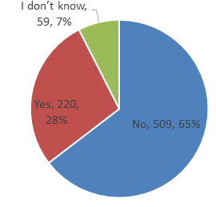
Have you used the Birmingham SEND Local Offer Website in 2022 (www.localofferbirmingham.co.uk)
How useful has the website been for you in 2022?

Slide 8
Parent Carer Survey May 2022 – Key Findings
Measure | May 2022
Number of Parent Carers responding to surveys | 788
Overall Parent Carer SEND Satisfaction is “Good” or “Very Good” (all) | 32%
% Parent Carers sayings SEND Services have improved in the last year (all) | 27%
% Parent Carers who have accessed the SEND Local Offer Website | 28%
% Parent Carers who have accessed the SEND Local Offer Website who think it is OK, Good, Or Very Good | 72%
% Parent Carers who feel updated and informed about SEND services in Birmingham | 42%
% Parent Carers who feel they have had an opportunity to give feedback about SEND services in Birmingham | 26%
% Parent Carers who feel they have had an opportunity to influence changes in the SEND Services available in the city | 16%

Slide 9
Parent Carer Survey May 2022 – Next Steps (1)
We will publish this report on the Birmingham SEND Local Offer Website in July to ensure everyone can read it.
This report will act as a ‘baseline’ by which to measure our progress in better engaging parent/carers with Children with additional needs in Birmingham.
There will be ongoing and regular liaison between the SEND Improvement Team and Parent Carer Forum meetings to coordinate forward engagement activities and opportunities which will be advertised on the SEND Local Offer website.
Given the urgency to make SEND transformation in Birmingham, we need to ask parent carers for regular feedback regarding whether we are improving. Therefore we will repeat this every six months initially, next in November 2022 and then again in May 2023.

Slide 10
Next Steps (2)
And finally more engagement with Children and Young People experiencing SEND services is needed also– a similar survey is planned to be undertaken with Young People aged 13-29 in July 2022 alongside engagement events.

Slide 11
Social media final slide

