Slide 1



Slide 2


What is the Local Offer website?
Every Local Authority in England has a duty (by law) to provide children and young people, (0-25 years) with support if they have Special Educational Needs and/or Disabilities - this is known as the Local Offer. Every Local Authority has to publish what support is available on the Local Offer website.
This Local Offer website gives information about the support that the local authority expects to be available across education, health and social care. The information on the website is clear and easy to find. It says who a particular service is for, how to apply, and how decisions are made about who gets that service.​

Slide 3


What is on the Local Offer website?
Help, support and advice for families, carers, children and young people on their SEND journey
We want the site to be ‘one-stop’ self service help and support – a 111 for SEND
Includes information from the NHS, the Local Authority and the Children’s Trust, plus a directory of SEND support

Slide 4
What children, young people, parents and carers said about the Local Offer website in early 2022
‘I didn’t know it existed’ ​
​
‘It’s really hard to navigate’​
​
‘It’s too corporate – there is too much jargon’​
​
‘I can’t find what I want on it’​
​
‘There’s nothing about short breaks’
‘There’s nothing for children and young people’​
​
‘I can’t find what I need to know about EHCPs’​
​
‘I can’t find the documents I need’​
​
‘It’s out of date’​
​
‘It’s a minefield’​

Slide 5
You Said, We Did….
You Said - It’s hard to find anything on the Local Offer
We Did – We’ve made it much easier to find your way round the site and created dedicated areas for parents and carers, children and young people and professionals.
You Said – We want a directory of all SEND resources in Birmingham
We Did – We have created a searchable directory of resources, support and information for children and young people with additional needs. Please tell us if you know of other information that we should have there!
You Said – We need better information about the SEND system and where to go for help
We Did – The website now includes clear information on finding support for children and young people with additional needs and who to contact and timelines for SENAR processes.

Slide 6
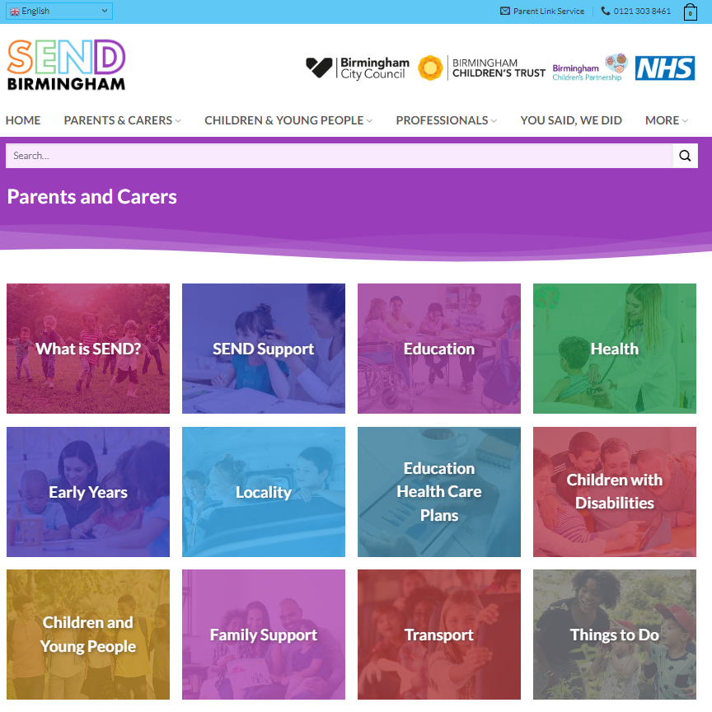
What we have done to improve the website
Talked to a wide range of stakeholders to find out what they wanted to see on the website
Analysed visitor traffic to identify the most popular pages and make them easy to find
Included a new searchable directory of support and resources
Ensured that SEND systems and processes are explained
Improved navigation by using bold tiles so it’s easier to find what you need
Made sure it is all up to date

Slide 7
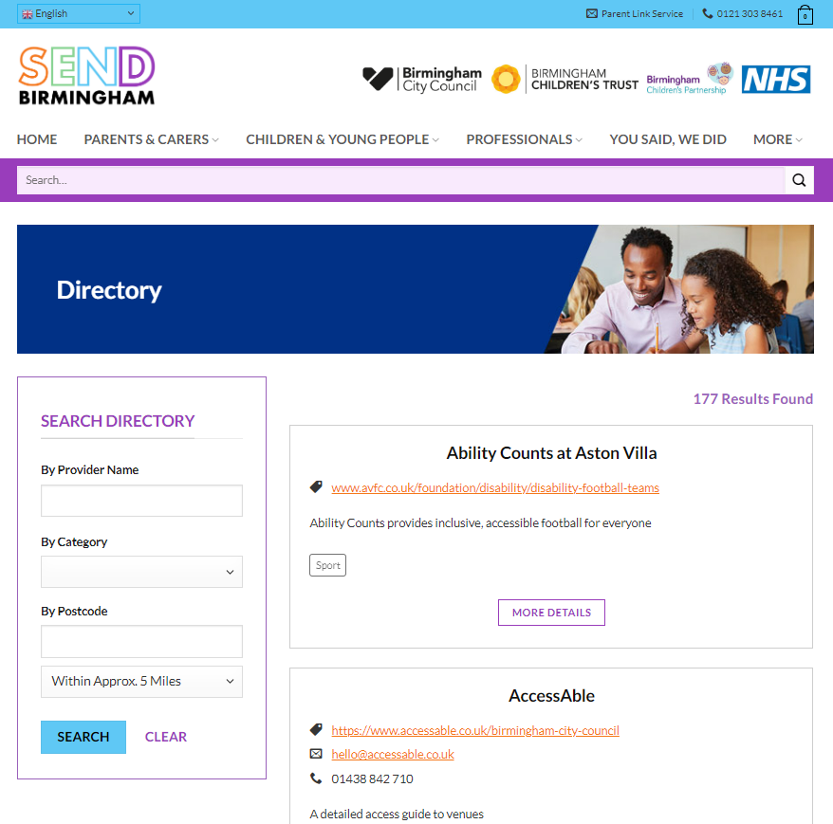
What we have done to improve the website
Included up to date documentation which is easy to find
Improved our offering for children and young people, although we know we still have a way to go there….
Included new pages on Autism and ADHD
Included new information on support for employment
Included a new section on SEND support and advice
Tested the website with parents, carers, children, young people and professionals.

Slide 8

Watch the SEND Local Offer website video to find out more.

Slide 9

The New SEND Brand for Birmingham
The new SEND brand for Birmingham means that it is easier to instantly recognise where there is help and support for families, parents, carer and children and young people with additional needs.

Slide 10
A new ways of communicating
The website roll out will be accompanied by a commitment to better communication with parents, carers, children and young people with the following key messages:
We are listening and we know that things have not been good in SEND Services and we are working to strengthen them
We know we still have a long way to go to get things right, including how we communicate.
We are committed to partnership and co-production ensuring that parents, carers, schools and settings, staff young people children are at the heart of decision making – ‘nothing about us without us’.
We want to demonstrate and communicate change for the better and will focus on newsletters and updates, as well as social media where we can share ‘green shoots’.

Slide 11
A new ways of communicating
We want schools, education settings, professionals and providers to understand the need for change and what their part is in that.
We are also working with schools, education settings and professionals to improve our SEND offering and how we communicate that.
We are working on a SEND strategy for the city which will bring effective and long-lasting improvements to the system.
We want to create meaningful and two-way dialogue with stakeholders which is accessible, offers useful and relevant information and affords the opportunity to feedback and contribute. We know we have a way to go with that yet.
We are improving the SEND Local Offer website with parents, carers, schools and educational settings children, young people and professionals so that it is a wholly effective resource.

Slide 12


