Slide 1
Welcome
Introductions

Slide 2
What do we mean by
co-production?

Slide 3
Defining what is meant by co-production
“Co-production is a way of working, where everybody works together on an equal basis to create a service or come to a decision which works for them all. Co-production is a process that involves citizens in the design and delivery of services.”

Slide 4
Building on people’s existing capabilities
Value all participants with reward (reciprocity) and mutual support
Peer support networks
Blurring distinctions with building trust and shared power and responsibility
Facilitating rather than delivering
Taking an asset based approach

Slide 5
The Public Service Matrix
 | Professionals as sole service planner | Service users/ community& professionals as co-planners | No professional input into service planning
Professionals as sole service delivers | Traditional professional service provision | Professional service provision -users and communities involved in planning and design | Bespoke services commissioned by users and delivered by professionals
Professionals/ users/ communities as co-deliverers | User co-delivery of professionally designed services | Full user/ professional/ community co- production | User/ community delivery of services with little formal/ professional planning or design
Users/ communities as sole deliverers | User/ community delivery of professionally planned services | User/ community delivery of co- planned or co- designed services | Self-organised community provision
 | Professionals as sole service planner | Service users/ community& professionals as co-planners | No professional input into service planning
Professionals as sole service delivers | Traditional professional service provision | Professional service provision -users and communities involved in planning and design | Bespoke services commissioned by users and delivered by professionals
Professionals/ users/ communities as co-deliverers | User co-delivery of professionally designed services | Full user/ professional/ community co- production | User/ community delivery of services with little formal/ professional planning or design
Users/ communities as sole deliverers | User/ community delivery of professionally planned services | User/ community delivery of co- planned or co- designed services | Self-organised community provision

Slide 7
What are the benefits?
Increases people’s self-worth and confidence, as well as providing skills and experience.
Everyone can benefit from peer networks and support and gain a new sense of purpose.
It can be motivating for staff running services and can re-ignite their passion for their job.
Co-production can make services a better fit for the people that use them, and more accessible.

Slide 8
What are the benefits?
Lived Knowledge - Individuals and communities are the experts in their own situation.
It can make an otherwise institutional situation feel more human.
It is cost effective – Get it right first time.
Future orientation – history is not essential

Slide 10
Three Levels of co-production
Transformative – equal
Intermediate - two way
Basic – one way

Slide 11
Transformative: citizens are equal partners in all aspects of commissioning, design, service delivery and evaluation. This approach transforms power and control.
An equal partnership regardless of diversity
Co-production embedded in practice at every stage
Led jointly by citizens and staff –’we’
All have a voice , are listened to and valued for their views
All will advocate for each other
Feedback provided is acted upon and details of actions are circulated
Citizens delivering training for staff on co-production
Attendance to team meetings/Cabinet Member/Management team meetings as equal contributors
Social workers co-producing a package of care and support needs jointly with service users, families and carers.
Commissioners procuring a contract with citizens involved throughout the decision making process.
Co-design, Co-produce, Co-deliver and
Co-commission

Slide 12
Intermediate: recognises what citizens can offer yet recognises that a power imbalance between citizens and professionals remains in place
Expecting a two way relationship – for example; sharing information and expecting to receive a response
An invitations to meet and share views
A consultation engagement activity: comment/survey/meeting
Requesting citizens views in order to influence change
Asking citizens to comment and make recommendations on a specific piece of work.
Involving citizens in meetings – but not as equals
Citizen representation on Boards in order to influence discussions
Representation on interview panels with decision regarding appointment being left with Professionals
Mystery shopping by citizens to inform service delivery

Slide 13
Basic: acknowledges people's action as essential to the desired outcome. One way communication
Influencing peoples’ views – Tokenism
Informing people (or telling people)
Sharing details of something
Giving information about an activity (no response required)
Giving advice
Signposting to services/information elsewhere
Raising awareness

Slide 14
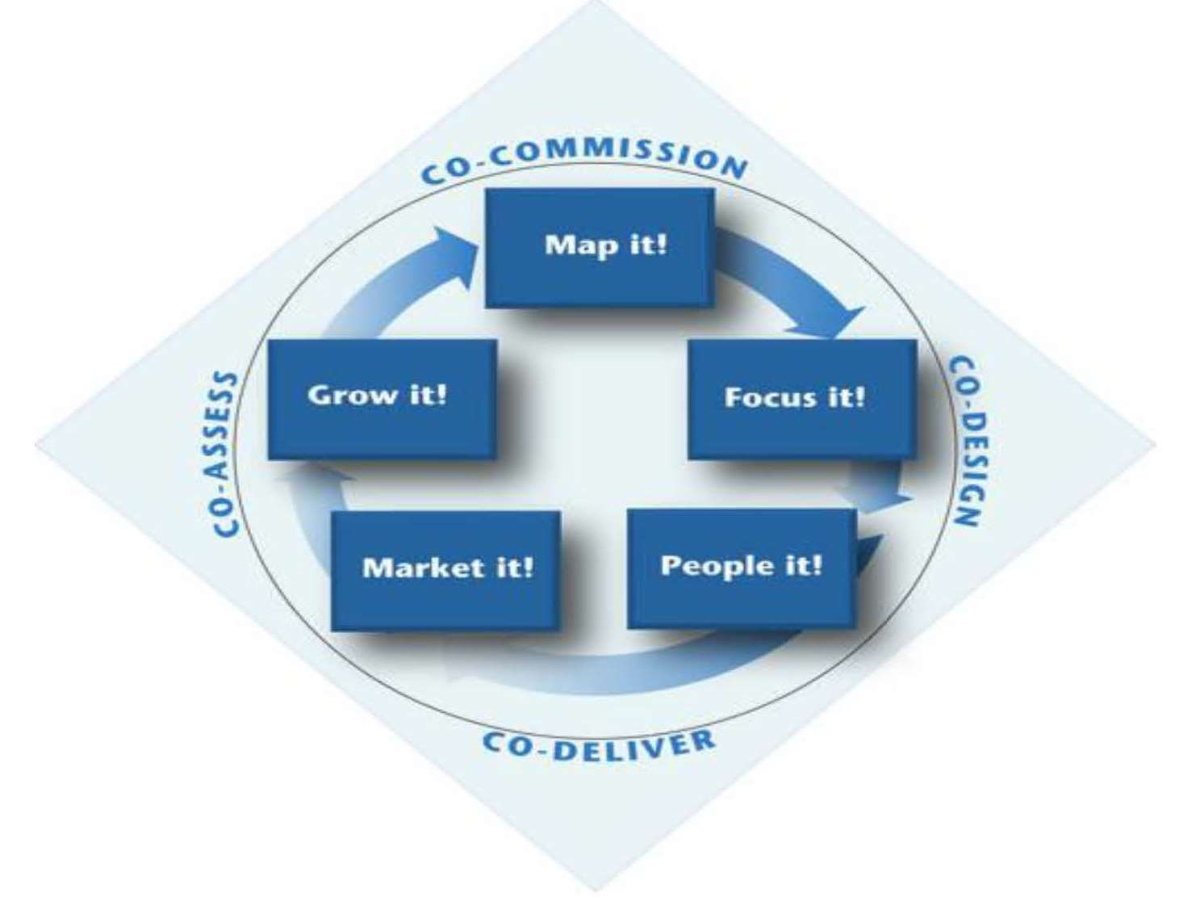

Slide 15
Citizen Involvement Team
Digital an
@brumgetinvolved

