Slide 1

Using The OAG In Your School – Information for School Leaders
Slides to share with leaders:
Birmingham’s Ordinarily Available Guidance (OAG)

Slide 2
Using The OAG In Your School – Information for School Leaders
The Ordinarily Available Guidance (OAG) helps schools and education settings maintain high-quality, inclusive practice. It provides a clear, shared expectation of what we do every day to create inclusive classrooms and learning environments. It supports whole-school expectations for inclusive practice and day-to-day inclusive teaching and support, enabling staff to respond to children and young people’s strengths and needs and to create welcoming learning environments that are inclusive, nurturing and ambitious for all.
Section One - Expectations for Inclusive Practice in All Settings
Section Two - Support for the Four Broad Areas of Need
Section Two supports teachers and support staff with day-to-day inclusive practice. It is organised around the broad areas of need in the SEND Code of Practice and describes what we might see and what we can do to support learning and participation.
The strategies reflect ordinarily available provision within mainstream settings and can be used flexibly, recognising that children and young people may have needs across more than one area.
Section One sets out the whole-school expectations for inclusive practice that all education settings in Birmingham are expected to have in place for all children and young people, including those with SEND.
The section is structured around 10 key principles that describe what strong, inclusive practice looks like across a setting.
Use Section One to:
Use Section Two to:
Reflect on what inclusive practice looks like across your setting
Review how welcoming environments are created and maintained
Consider how strengths, interests and potential are recognised and supported
Support whole-school learning, development and induction
Guide professional conversations in meetings and reviews
Leaders and governors can use the 10 key principles to reflect on what is working well and identify next steps.
Support staff in recognising children’s strengths and needs
Respond to ‘what we might see’ with strategies to support learning and participation
Guide professional conversations about teaching and support
Strengthen collaboration with parent carers and partner professionals
Section Two supports day-to-day inclusive teaching and learning and helps staff respond confidently and consistently.
Birmingham’s Ordinarily Available Guidance (OAG)

Slide 3
Using The OAG In Your School – Information for School Leaders
The Ordinarily Available Guidance (OAG) helps schools and education settings maintain high-quality, inclusive practice.
It provides a clear, shared expectation of what we do every day to create inclusive classrooms and learning environments.
It supports whole-school expectations for inclusive practice and day-to-day inclusive teaching, enabling staff to respond to children and young people’s strengths and areas for development and to create welcoming learning environments that are inclusive, nurturing and ambitious for all.
Birmingham’s Ordinarily Available Guidance (OAG)

Slide 4
Section One - Expectations for Inclusive Practice in All Settings
Section One sets out the whole-school expectations for inclusive practice that all education settings in Birmingham are expected to have in place for all children and young people, including those with SEND.
The section is structured around 10 key principles that describe what strong, inclusive practice looks like across a setting.
Use Section One to:
Reflect on what inclusive practice looks like across your setting
Review how welcoming environments are created and maintained
Consider how strengths, interests and development areas are known and supported
Support whole-school learning, development and induction
Guide professional conversations in meetings and reviews
Leaders and governors can use the 10 key principles to reflect on what is working well and identify next steps.
Birmingham’s Ordinarily Available Guidance (OAG)

Slide 5
Section Two - Support for the Four Broad Areas of Need
Section Two supports teachers and support staff with day-to-day inclusive practice. It describes what we might see and what we can do to support learning and participation.
The strategies reflect ordinarily available provision within mainstream settings and can be used flexibly, recognising that children and young people may have needs across more than one area of need.
Use Section Two to:
Support staff in recognising children’s strengths and areas of development
Respond to ‘what we might see’ with strategies to support learning and participation
Guide professional conversations about teaching and support
Strengthen collaboration with parent carers and partner professionals
Section Two supports day-to-day inclusive teaching and learning and helps staff respond confidently and consistently.
Birmingham’s Ordinarily Available Guidance (OAG)

Slide 6
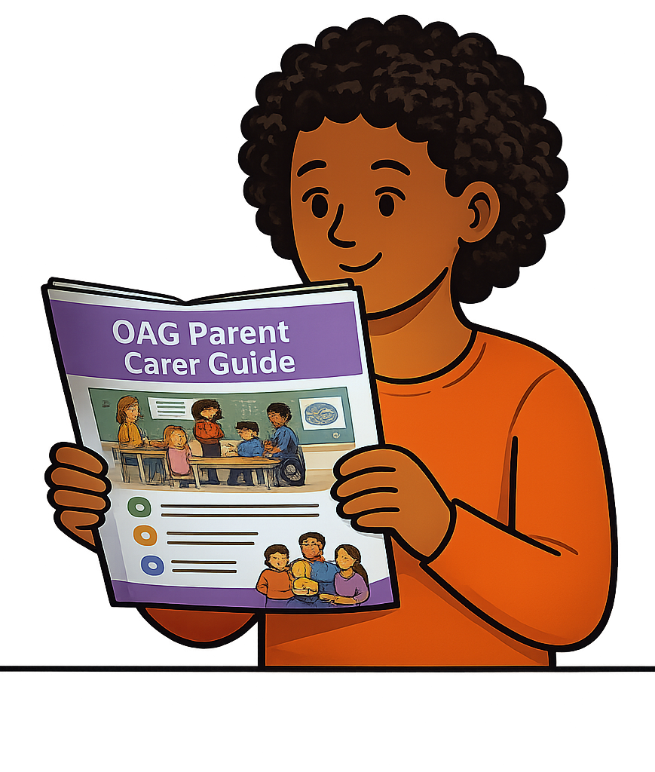
Using the Parent Carer Guides in School
The Parent Carer Guides help schools have clear and confident conversations with families about Birmingham’s Ordinarily Available Guidance (OAG).
Schools can use the guides to:
Support conversations about what inclusive practice looks like in your school
Explain what you are doing to support a child
Explain what families can expect and how they can be involved
Keep messages consistent across staff
Build strong partnerships with parents
They are a simple tool to help explain your approach and make support clearer for families.
They can be used…
When concerns are first raised
In planning and review meetings
During transition conversations
At parents’ evenings and open day events
In parent workshops or information sessions
On the school website
Birmingham’s Ordinarily Available Guidance (OAG)
Notes:
This can be shared with all staff in school so parent carers are supported with consistent information

Slide 7
Using The OAG In Your School – Information for parents
Slides to share with parent carers and families:
Birmingham’s Ordinarily Available Guidance (OAG)

Slide 8
Using the Parent Carer Guides in School
The Parent Carer Guides help schools have clear and confident conversations with families about Birmingham’s Ordinarily Available Guidance (OAG).
Schools can use the guides to:
Support conversations about what inclusive practice looks like in your school
Explain what you are doing to support a child
Explain what families can expect and how they can be involved
Keep messages consistent across staff
Build strong partnerships with parents
They are a simple tool to help explain your approach and make support clearer for families.
They can be used…
When concerns are first raised
In planning and review meetings
During transition conversations
At parents’ evenings and open day events
In parent workshops or information sessions
On the school website
Birmingham’s Ordinarily Available Guidance (OAG)
Notes:
This is what school share with their classroom practitioners so they are getting the same consistent message

Slide 9
What is the Ordinarily Available Guidance (OAG)?
The OAG is Birmingham’s shared SEND guidance for all mainstream schools and settings.
It explains the support that should be available for children and young people every day.
The OAG applies to all children. Not just those with a diagnosis or an EHC Plan
It supports schools to respond early when children need extra help
It helps parents, schools and professionals use shared language and expectations
It focuses on what schools can do within their everyday resources

Slide 10
What does this mean for your child?
It means that schools are expected to:
notice when a child is finding things difficult
adapt teaching and routines to remove barriers
put support in place without waiting for things to get worse
work in partnership with you
Your child does not need a diagnosis or formal plan for this support to begin.

Slide 11
How do schools use the OAG?
Schools use the OAG to:
develop inclusive classroom practice
make changes and adaptations
make decisions about additional support
guide conversations with parents about needs and next steps
It helps teachers to think about:
What are we noticing in the classroom?
What can we try now?
What’s working and what needs to change?

Slide 12
Working Together – How to help
You know your child best. Schools value your knowledge and experience. You can:
share what you notice at home
ask how the OAG is being used to support your child
take part in review conversations
raise concerns early. You don’t need to wait until things get worse
Working together helps schools put in the right support at the right time.

Slide 13
Using the OAG Parent Carer Guides
There are 10 short Parent Carer Guides you can use if you want more information.
Each guide focuses on a specific topic.
They explain what schools are trying to do and show how you can be involved.
You don’t have to read everything all at once. Schools may point you to a guide that is most helpful for your child.

Slide 14


Slide 15


Slide 18
Using The OAG – Information for Teachers and Support Staff
Slides to share with Teachers and Support Staff
Note for Session Lead (SENCo / SLT):
These slides support a short introduction to Section 2 of the Ordinarily Available Guidance (OAG).
The aim is to help staff feel confident using it in everyday classroom practice.
This is not about adding something new, it’s about supporting what we already do.
Section 2 focuses on practical strategies we can use straight away.
Birmingham’s Ordinarily Available Guidance (OAG)

Slide 19
Using The OAG – Information for Teachers and Support Staff
The Ordinarily Available Guidance (OAG) helps all schools and education settings maintain high-quality, inclusive practice. It provides a clear, shared expectation of what we do every day to create inclusive classrooms and learning environments.
What is Section Two of the Ordinarily Available Guidance?
Section Two of the Ordinarily Available Guidance (OAG) provides practical support for teachers, teaching assistants and other staff who work directly with children & young people.
It helps staff recognise when a child or young person may be finding something difficult and suggests practical strategies that can be tried in everyday teaching and support.
Section 2 is organised around the four broad areas of need described in the SEND Code of Practice.
Within each area, the guidance describes what staff might notice and suggests practical strategies that can be used in everyday teaching.
Every child and young person is different, so the guidance should be used flexibly. Staff should select and adapt approaches that best support the individual needs, strengths and interests of the child or young person.
Birmingham’s Ordinarily Available Guidance (OAG)
Notes:
Presenter notes:
Use this slide to give an overview of Section 2 – what it is.

Slide 20
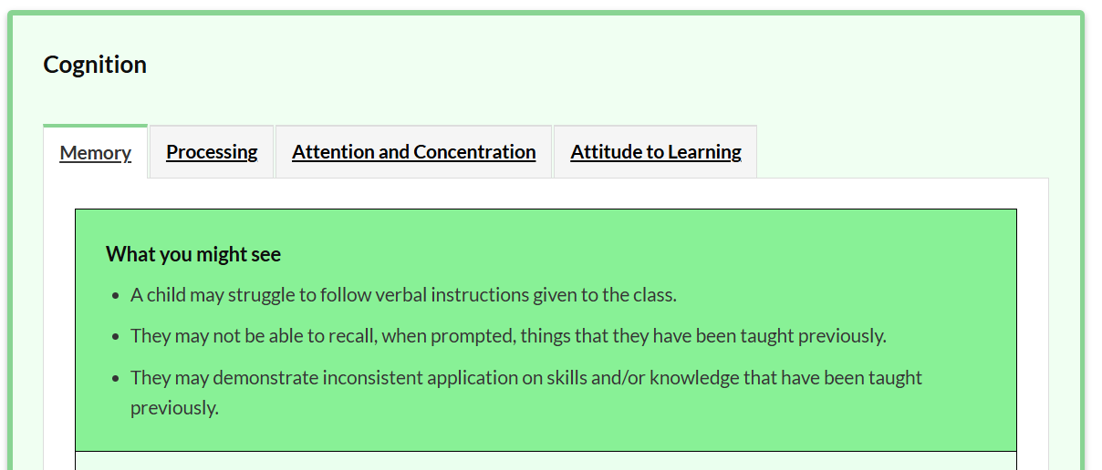
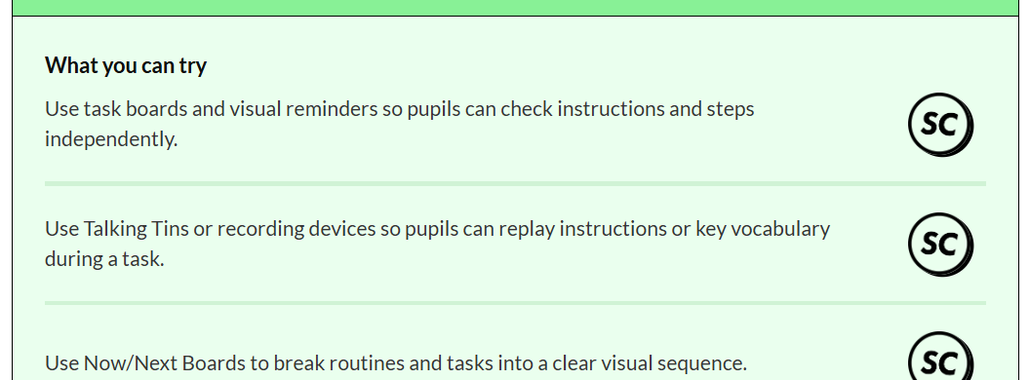
How the Section Two guidance is organised
Each section is organised using two simple headings:
“What you might see” and “What you can try”
“What you might see”
This describes some of the signs that a child or young person may be experiencing difficulty in a particular area.
“What you can try”
This provides practical ideas and strategies that staff can use in the classroom to support the child or young person.
Birmingham’s Ordinarily Available Guidance (OAG)
Notes:
Presenter notes:
Every area follows the same simple structure:
What you might see
What you can try
“What you might see”:
helps you reflect on what you are noticing
“What you can try”:
gives practical strategies you can use straight away
👉 Emphasise:
You don’t need to read everything
You can dip in quickly based on what you’re seeing
👉 Key phrase:
“Notice → match → try”
The strategies are intended to be helpful, practical suggestions that can be tried as part of everyday teaching. In many cases, staff can try these approaches without needing to involve the SENCO or external services straight away.
Staff are encouraged to try different strategies, notice what helps, and record what works well or where concerns remain. This helps build a clearer understanding of the child’s needs and supports the Assess – Plan – Do – Review process used in schools.

Slide 21
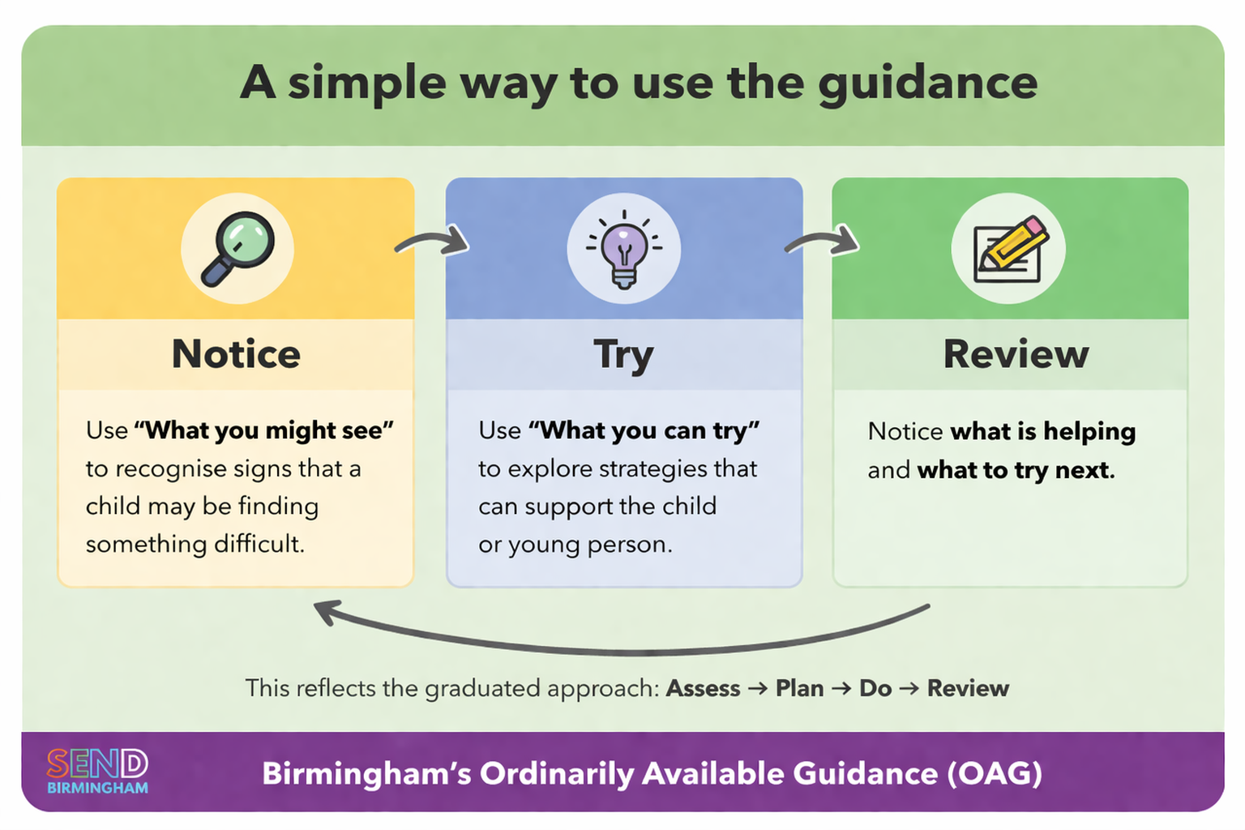
Notes:
Presenter Notes – “A simple way to use the guidance”
This slide is about simplifying how to use Section 2 in everyday classroom practice.
The guidance is structured to support a simple, repeatable cycle that staff can use as part of their normal teaching, not as something additional.
🟨 Notice
Start by looking at “What you might see.” This helps you recognise when a child may be finding something difficult.
This is not about diagnosing or labelling, it’s about noticing patterns in learning, behaviour, or participation that might indicate a barrier.
🟦 Try
Then move to “What you can try.” This gives practical strategies that can be used straight away in the classroom.
The key message here is:
you don’t need to wait
you don’t need something separate or specialist
these are approaches that are part of everyday teaching and support
🟩 Review
After trying strategies, notice what is helping and what to try next.
This is about:
adapting your approach
building on what works
and continuing to refine support
It links directly to what staff already do. It’s not about creating extra paperwork. Staff may fine using 4+1 Questions Person Centred Thinking Tool helpful for this.
🔄 Link to Graduated Approach
This cycle reflects the graduated approach: Assess → Plan → Do → Review
What this slide does is translate that into a simple classroom habit:
Notice
Try
Review
🎯 Key message to emphasise
This is not a one-off process.
It’s something staff can:
use daily
use flexibly
and apply to any child they are supporting
💬 Optional prompt for staff (if interactive)
You might ask:
“Can you think of a child in your class where you could use this cycle straight away?”
✅ Why this works
Reinforces simplicity
Anchors directly to the structure of Section 2
Keeps it practical and low-burden
Bridges guidance → classroom practice

Slide 22
Using the guidance in practice
Section Two helps you to identify and respond to emerging needs by using practical strategies as part of a graduated approach.
If a child seems to be having difficulty with something, you can:
🔍 Look at “What you might see” to find statements that reflect what you are noticing.
💡 Explore the “What you can try” and select approaches that may help.
▶️ Try these approaches in everyday teaching and support.
📝 Note what is helping and what remains challenging.
👥 Share this information with the SENCO if further support may be needed.
Birmingham’s Ordinarily Available Guidance (OAG)
Notes:
Presenter notes:
This links directly to what we already do in the classroom.
If a child seems to be finding something difficult:
Look at What you might see
Check if it reflects your observations
Explore What you can try
Try strategies in your teaching
Notice what helps
Share with SENCo if needed
👉 Emphasise:
This is part of the graduated approach
It supports early action, not waiting
👉 Key message:
“Try first, then review — don’t wait for it to become a bigger issue.”

Slide 23
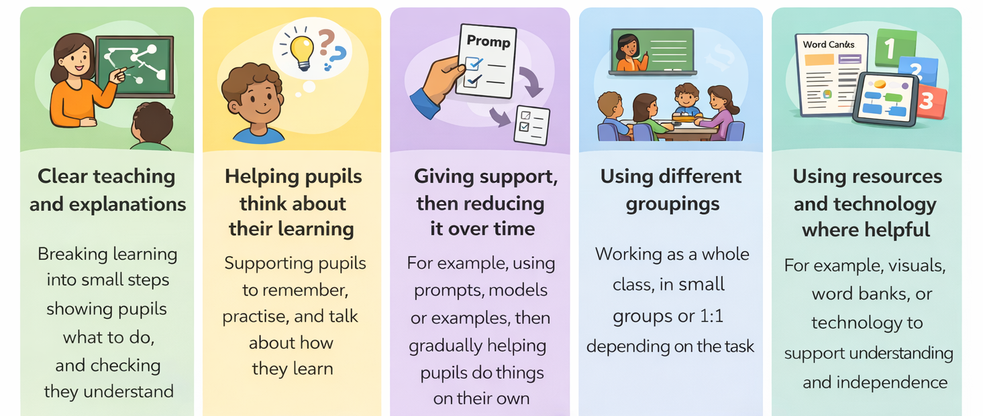
Adaptive teaching comes first
The strategies in this Section Two of the OAG are there to help, but they should not replace high-quality adaptive teaching. They are designed to be used alongside it. Before trying new strategies, it is important to think about how teaching is already being adapted to support all pupils. The EEF describe high-quality adaptive teaching as:
Prompt
Word bank
Once these are in place, the “What you can try” strategies can be used to give extra support in a specific area, provide more structure, repetition or practice and help meet the needs of an individual child or young person
Teaching and support should be reviewed regularly to see what is working well and what may need to change.
Notes:
Presenter notes:
The guidance does not replace high-quality teaching.
It sits alongside adaptive teaching.
Before using additional strategies, think about:
how learning is being broken down
how understanding is checked
what scaffolds are in place
how groups are organised
👉 Then:
use strategies to provide additional support or structure
👉 Emphasise:
“This builds on good teaching — it doesn’t replace it.”

Slide 24
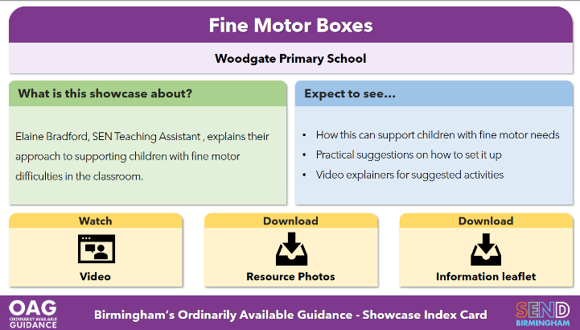
Seeing it in practice
Showcases from Birmingham Schools and Settings in the ‘Digital Library’
Showcase Cards
The OAG Digital Library includes real examples from schools and settings across Birmingham showing how inclusive strategies are used in practice.
These examples may include short videos, case examples and downloadable resources. They are designed to help staff see what inclusive practice looks like in real classrooms and settings.
Birmingham’s Ordinarily Available Guidance (OAG)
Notes:
Presenter notes:
Alongside the guidance, there is a Digital Library.
This includes:
real examples from schools
videos
case studies
resources
👉 Purpose:
to help staff see what this looks like in real classrooms
👉 Emphasise:
Not just theory — real Birmingham practice
You don’t need to “get it perfect” — this is about learning and adapting

Slide 25

Which version should I use?
There are three colour-coded versions of the guidance
In some cases, it may be helpful to look across versions.
For example:
Children in Reception who may benefit from approaches in both the Early Years and School Age guidance
Young people preparing for Post-16 and adulthood who may still benefit from strategies in the School Age guidance
Staff should use their professional judgement and select strategies that best support the child or young person.
Notes:
Presenter notes:
There are three versions:
Early Years
School Age
Post-16
Usually, use the one that matches the child’s age.
But:
sometimes it helps to look across versions
👉 Example:
Reception pupils
Year 11 pupils preparing for Post-16
👉 Emphasise:
“Use your professional judgement — this is a tool, not a rule.”

Slide 26
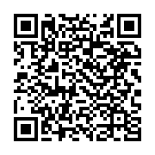
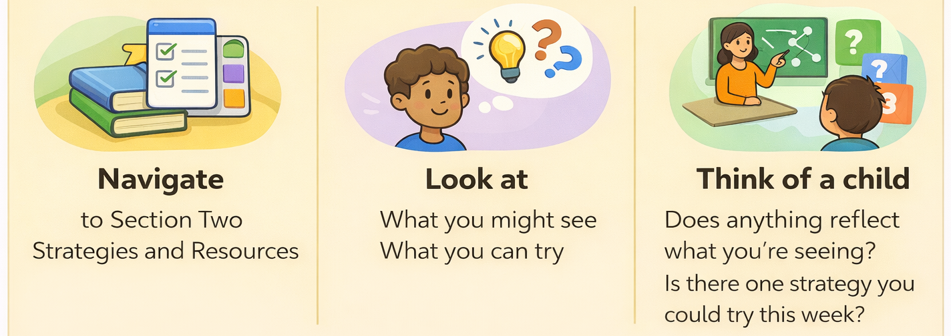
ACTIVITY: Explore Section Two of the guidance
Spend some time exploring Section Two of the Online Ordinarily Available Guidance (OAG)
localofferbirmingham.co.uk/online-ordinarily-available-guidance
What to do…
Notes:
Presenter notes:
👉 This is the most important slide
We’re now going to spend a few minutes exploring the guidance.
Ask staff to:
Go to the online OAG
Select School Age
Choose one area of need
Look at:
What you might see
What you can try
👉 Then prompt:
Think of a child in your class
Does anything reflect what you’re seeing?
Is there one strategy you could try this week?
👉 Optional pair discussion:
What stood out?
What might you try?
👉 Emphasise:
“This only works if we use it — just pick one thing to try.”

Slide 27
Next Steps: Notice → Try → Review → Share
Can you think of a child in your class where you could use this cycle straight away?
Notes:
Presenter notes:
This is the process behind the guidance
It’s what we already do. This just makes it clearer
“Can you think of a child in your class where you could use this cycle straight away?”
Finally – please share how its going with your SENCO / Inclusion lead.

