Slide 1


Task:
What do you think the term co-production means? Please use the post it notes to detail your responses

Slide 2
House Keeping
Health & Safety
Phones on silent
Safe & Confidential Space
Listen and avoid interruptions
Photo Consent?
It’s ok to disagree respectfully
Be present
Enjoy the Session!
There’s no such thing as a silly question

Slide 3
Ice Breaker & Introductions
Introduce yourselves to one another and feedback an interesting fact such as your hobby, football team, food… etc.

Slide 4
Aims of the session
Define Co-production
Share lived experiences – sensitive and emotive subjects will be discussed during the session
Understand the benefits of working together
Learn about the Co-production Award Scheme
Notes:
3 mins Ali or David
Script:
"This session has a few key aims, which we’ll explore together. Here’s what we’ll focus on today:"
Hearing Real Perspectives:
"We’ll start by hearing from young people and parent carers to understand co-production from their point of view."
Sharing Experiences:
"Next, we want to celebrate your experiences with co-production, including any opportunities you’ve found to make it work in your setting."
Understanding the Benefits:
"We’ll look at the practical benefits of co-production—how it can help you, your team, and the people you support."
Defining Co-Production and the 4Cs:
"We’ll go over what co-production really means and explore the '4Cs' framework from the SEND Co-production Charter."
SEND Co-production Award Scheme:
"Finally, we’ll introduce the SEND Co-production Award Scheme, which you can use to demonstrate and celebrate the impact of co-production in your work."

Slide 5
Definition of Co-production
Co-production is about placing equal value on the contributions of children, young people, parents, carers and professionals in making decisions and improving the services received and the experiences and outcomes of those living with SEND in Birmingham’
Co-production, therefore, requires involving people openly and inclusively right from the very start of their experiences with public services, as a means of building and maintaining trust, so that they can contribute fully to the commissioning, design, delivery and evaluation of services and outcomes.’ 2022

Slide 6
8 Guiding Principles
Trusted and able to trust
Listened to and heard
Treated with transparency and openness
Fully communicated with
Involved
Empowered
Equal
Accountable and able to hold to account

Slide 7
The 4 Cs of Co-production - Definitions
Co-commissioning | Involving parents, carers, and young people from the start in decisions about where resources go and how services are planned.
Co-design | Working together to plan and shape services or resources, ensuring they meet the real needs of those using them.
Co-delivery | Sharing the responsibility of providing services by involving parents, carers, and young people in delivering activities.
Co-assessment | Collaboratively evaluate services to identify what’s working and what could improve, using feedback from everyone involved.
Notes:
5 min Here we break down co-production into 4 key concepts (the 4 Cs: Co-commissioning, Co-design, Co-delivery, Co-assessment) into digestible modules and use ‘Real-World’ Scenarios to help show you what we mean by co-production.
Encourage participants to share their own examples.
We will go through a quick overview here and then use this model:
Definition - Write a clear, concise, straightforward text summary that explains what this means in simple terms.
Example - Real-world scenario - Create an imagined scenario that brings an example of co-commissioning to life. Write it in a way that would allow participants to consider how they would handle similar situations or opportunities.
Reflective Questions - Give me some of these for Co-Commissioning that encourage participants to think of similar opportunities or challenges in their work.
Key Takeaway - Summarise one action they can implement, e.g., “Start including parents in the initial meeting planning phase, or create a resource to help with this.

Slide 8
Examples of Co-production
Co- Commissioning | Co-design | Co-delivery | Co-assessment
Young people involved in enabling reasonable adjustments in health settings Families involved in fundraising activities for playground equipment Parent carers involved in Short Breaks commissioning | Parent carers involved SEND reports/ websites in schools Co-design promotional materials or questionnaires, or evaluation forms Co-designing training sessions and parent carer groups in schools | Involve people to share their lived experiences at events or meetings Co-deliver training sessions Involve people in video productions or podcasts | Include people in the evaluation of services Finding out what works well, what could be done differently etc Young people assessing the use of the Local Offer website

Slide 9
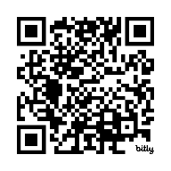
Working Together document
Notes:
10 mins The importance of this document:

Slide 10
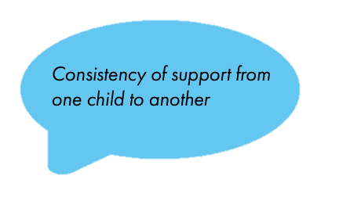
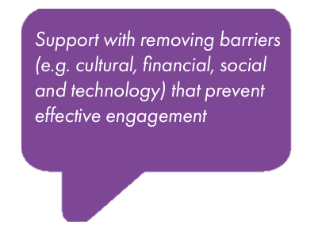
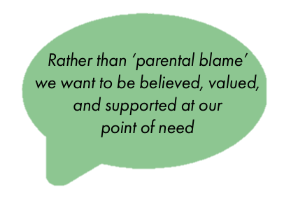
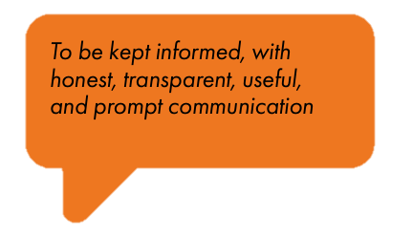
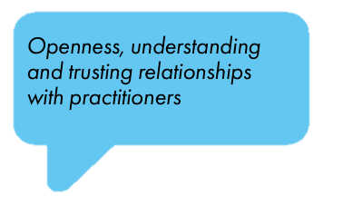

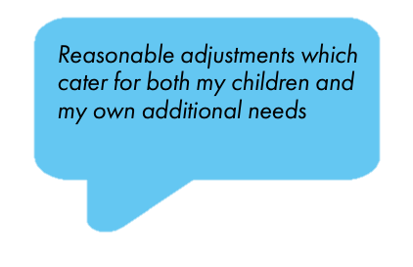
What parent carers told us they would like from engagement and participation
Notes:
Pam

Slide 11
Whole system approach...
Greater buy-in: When people feel genuinely involved, they are more likely to work towards common goals.
Diverse perspectives: Can lead to more creative solutions, innovations and making services more inclusive.
Enhanced resilience: A system that engages all parts of its community is more adaptable to change.
Sustainable change: By embedding engagement into the entire system, changes are more likely to be sustained over time.`
Notes:
Pam

Slide 12
Comfort break! (10mins)

Slide 13
Experts by Experience (EBE)
Notes:
Sharing Lived Experiences
TRIGGER Warning: mention that sensitive and emotive subjects will be discussed in this section.

Slide 14
Group Activity
Working with the people in the room, discuss practical ideas for each of the following categories to strengthen Co-production. Think about how in-person or online meetings might require different approaches.
Encouraging a Safe Space – How can we ensure everyone feels respected, heard, and comfortable sharing their views?
Warm and Welcoming Environment – What small changes or actions could make meetings and interactions more inviting?
Language and Communication – How can we adapt our language (e.g., avoiding jargon) to be more accessible and empowering?
Planning and Processes – What methods or tools could help involve people at every stage, from decision-making to assessment?
Notes:
“This example highlights how co-design works. Parents and students were invited to share their ideas early, and their insights helped shape the final plan. Everyone felt their input was valued, and the result was a program that met diverse needs.”
In the first session, the SENCO invites participants to share their ideas for making the outdoor space more accessible and calming. One student suggests a quiet corner with sensory plants, while a parent recommends adding wheelchair-accessible pathways. A teacher points out the need for shaded seating.
After gathering ideas, the group discusses practical constraints and decides on several features that are feasible within the school’s budget, such as a quiet area with sensory-friendly elements. The team agrees to have ongoing input as the project progresses, meeting monthly to ensure that the plans align with everyone’s vision.

Slide 15
Co-production – hints and tips
Language and communication
Allow the individual time to process the information, don’t rush and give people time
Make sure you use words that everybody understands and keep the language simple
Be mindful that parent carers may have additional needs themselves and may require support themselves
Explain acronyms because there is far too many across the services
Be mindful of your body language e.g. slouching, messing around with phones
Be present so that we know that you’re listening
Planning and processes
Be very clear of the purpose of the meeting and the expected outcomes for all involved
Ensure you have the right communication tools for that meeting/event e.g. PECS, Makaton, BSL signer, interpreter, hearing loop, electronic devices etc.
Send paperwork out to all invited attendees in advance of the meeting with guidelines if required.
Make any paperwork simple that anyone can read and understand. Think about the colour of paper
Review if the meeting/event has met its criteria at an appropriate time e.g. at the end of the meeting, with a follow up call or email when suitable for all parties.
Notes:
Pam

Slide 16
Co-production – hints and tips
Encouraging a safe space
Make sure no one is left out the conversation
Don’t be afraid to ask difficult questions
Be open and honest as this is how we build trust
Don’t be afraid to receive difficult feedback and try not to take it personally
Thank everyone for their time!
Warm and welcoming environment
Make everybody feel welcome and say hello, how are you?
Making sure the environment is suitable, accessible and takes reasonable adjustments into account
Be respectful
Make sure people understand and can hear you
Notes:
Pam

Slide 17

Co-production Award Scheme Information Pack

Slide 18
Co-production Award Scheme
The purpose of the Co-production Award Scheme is to:
1. Make a commitment to implement the Co-production Framework Charter across Birmingham.
2. Demonstrate the move from listening to people’s Voice to enabling meaningful Action
4. Ensure Co-production is integral to daily practice, meeting our legal and statutory obligations.
3. Recognise, measure, and celebrate co-production efforts.
Notes:
Laky

Slide 19
3 Stages of The Award Scheme
Organisations sign up to the Co-production Framework and Charter, showing their commitment to its principles
BRONZE
Organisations create an action plan covering the 4C’s of Co-production: Co commissioning, Co-design, Co-delivery, and Co-assessment.
SILVER
Organisations create an evidence portfolio showing how their action plan was implemented and its impact on improving lives.
GOLD
Notes:
Laky

Slide 20
Next Steps
Signpost your staff and parent carers to our in-person SEND Co-production training sessions: SEND co-production training Local Offer Birmingham
Sign up to the SEND Co-production Award scheme via the registration form! Award Scheme - Local Offer Birmingham
Tell us what you have done in a months' time by completing this Engagement - Local Offer Birmingham
Join the SEND Co-production Champions Group
Do you have any suggestions on how we can champion co-production?

Slide 21



Useful Resources
@SENDBirmingham
@localofferbirmingham
@birminghampcf
@birminghampcf

Slide 22
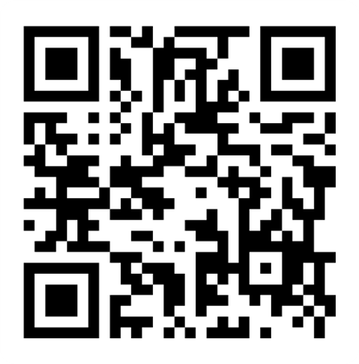
Co-production Training Evaluation Form

